Slide 1







The Space Race Leaders
Uwem Tom
23rd March, 2024

Slide 2



OUTLINE
Executive Summary
Introduction
Methodology
Results
Visualization – Charts
Dashboard
Discussion
Findings & Implications
Conclusion

Slide 3
EXECUTIVE SUMMARY
Summary of methodologies
-Data Collection through API
-Data Collection with Web Scraping
-Data Wrangling
-Exploratory Data Analysis with SQL
-Exploratory Data Analysis with Data Visualization
-Interactive Visual Analytics with Folium
-Machine Learning Prediction
•Summary of all results
-Exploratory Data Analysis result
-Interactive analytics in screenshots
-Predictive Analytics result

Slide 4
INTRODUCTION
Project background and context:
Space X advertises Falcon 9 rocket launches on its website with a cost of 62 million dollars; other providers cost upward of 165 million dollars each, much of the savings is because Space X can reuse the first stage. Therefore, if we can determine if the first stage will land, we can determine the cost of a launch. This information can be used if an alternate company wants to bid against space X for a rocket launch. This goal of the project is to create a machine learning pipeline to predict if the first stage will land successfully.
Problems to Solve:
-What factors determine if the rocket will land successfully?
-The interaction amongst various features that determine the success rate of a successful landing.
-What operating conditions needs to be in place to ensure a successful landing program.

Slide 5
METHODOLOGY: Data Collection
The data was collected using various methods.
Data collection was done using get request to the SpaceX API.
Next, we decoded the response content as a Json using .json() function call and turn it into a pandas dataframe using .json_normalize().
We then cleaned the data, checked for missing values and fill in missing values where necessary.
In addition, we performed web scraping from Wikipedia for Falcon 9 launch records with BeautifulSoup.
The objective was to extract the launch records as HTML table, parse the table and convert it to a pandas dataframe for future analysis.

Slide 6
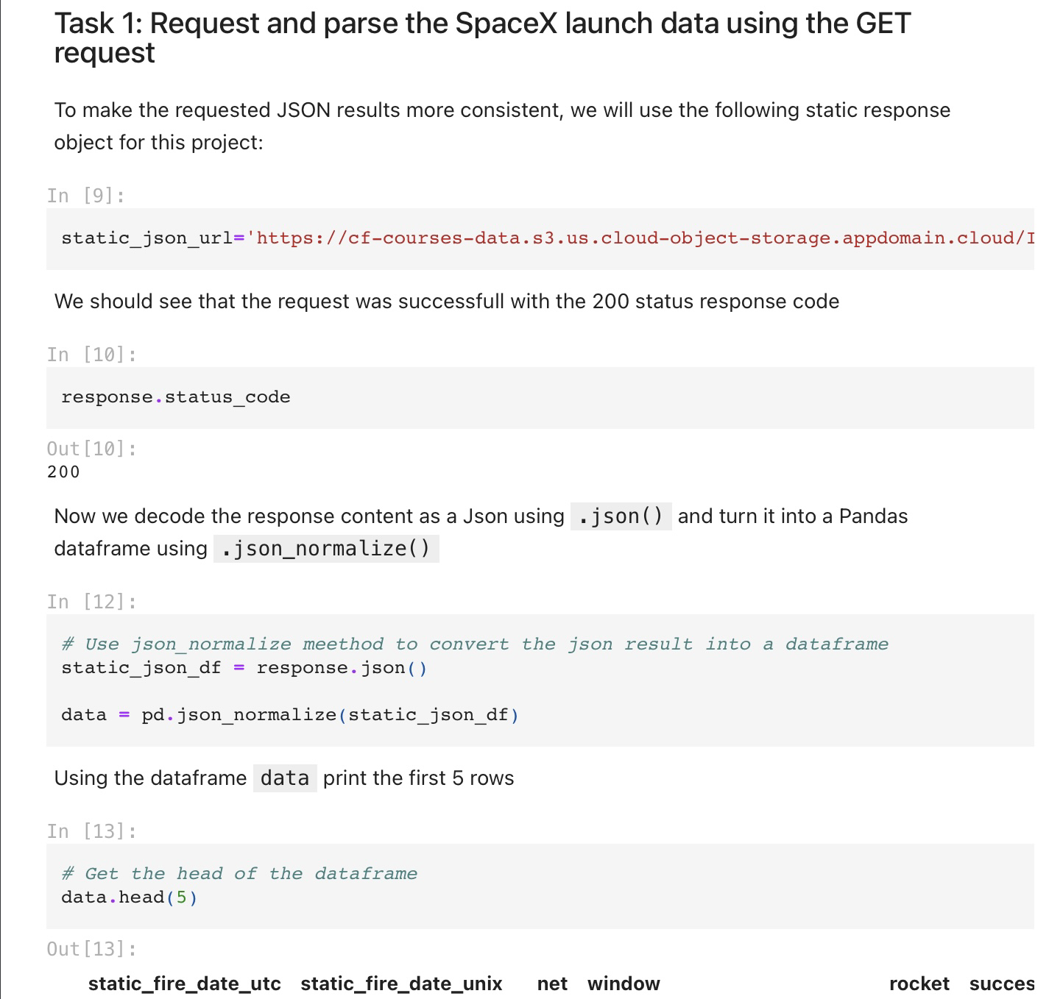
DATA COLLECTION: SpaceX API
We used the get request to the SpaceX API to collect data, clean the requested data and did some basic data wrangling and formatting.
The link to the notebook is SpaceX API Data Collection

Slide 7
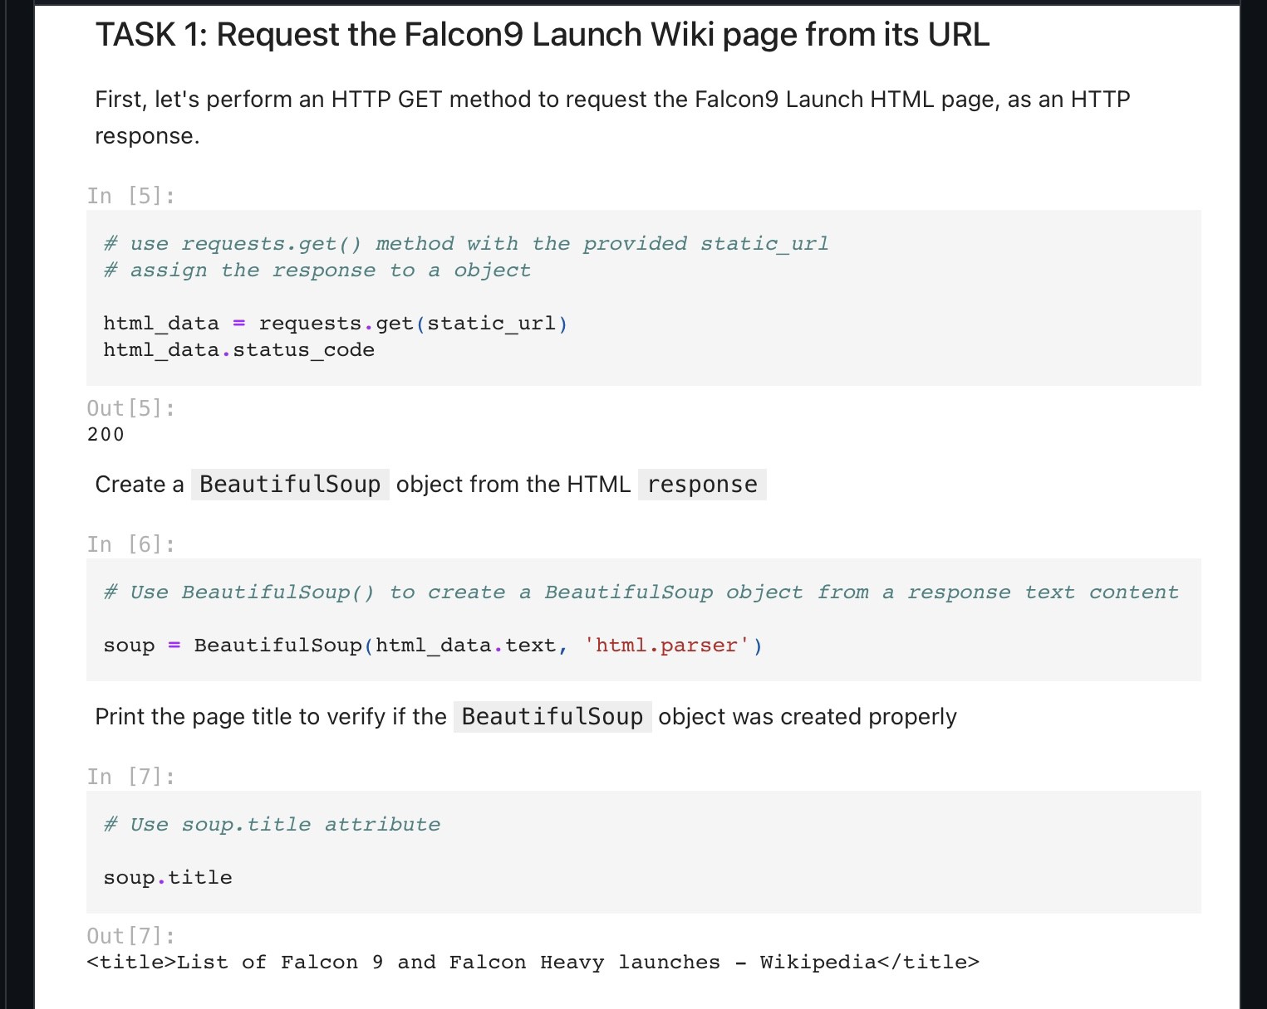
DATA COLLECTION: Webscraping
We applied web scraping to webscrap Falcon 9 launch records with BeautifulSoup
We parsed the table and converted it into a pandas dataframe.
The link to the notebook is Data collected via Webscraping

Slide 8
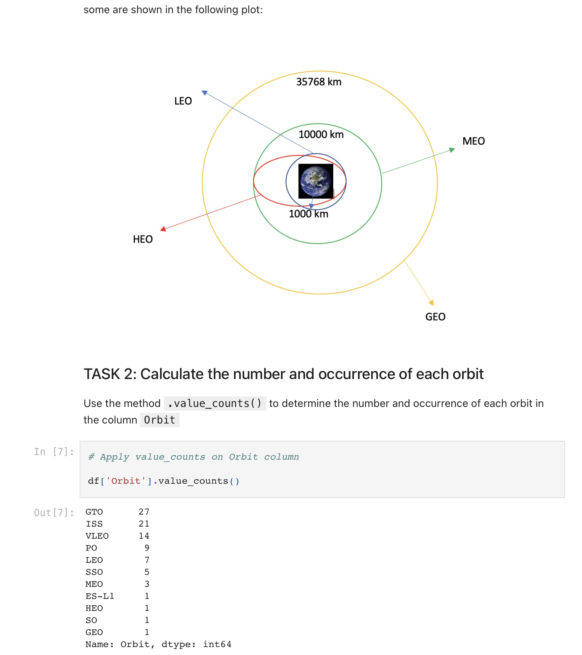
DATA WRANGLING
We performed exploratory data analysis and determined the training labels
We calculated the number of launches at each site, and the number and occurrence of each orbits
We created landing outcome label from outcome column and exported the results to csv.
The link to the notebook is Data Wrangling

Slide 9
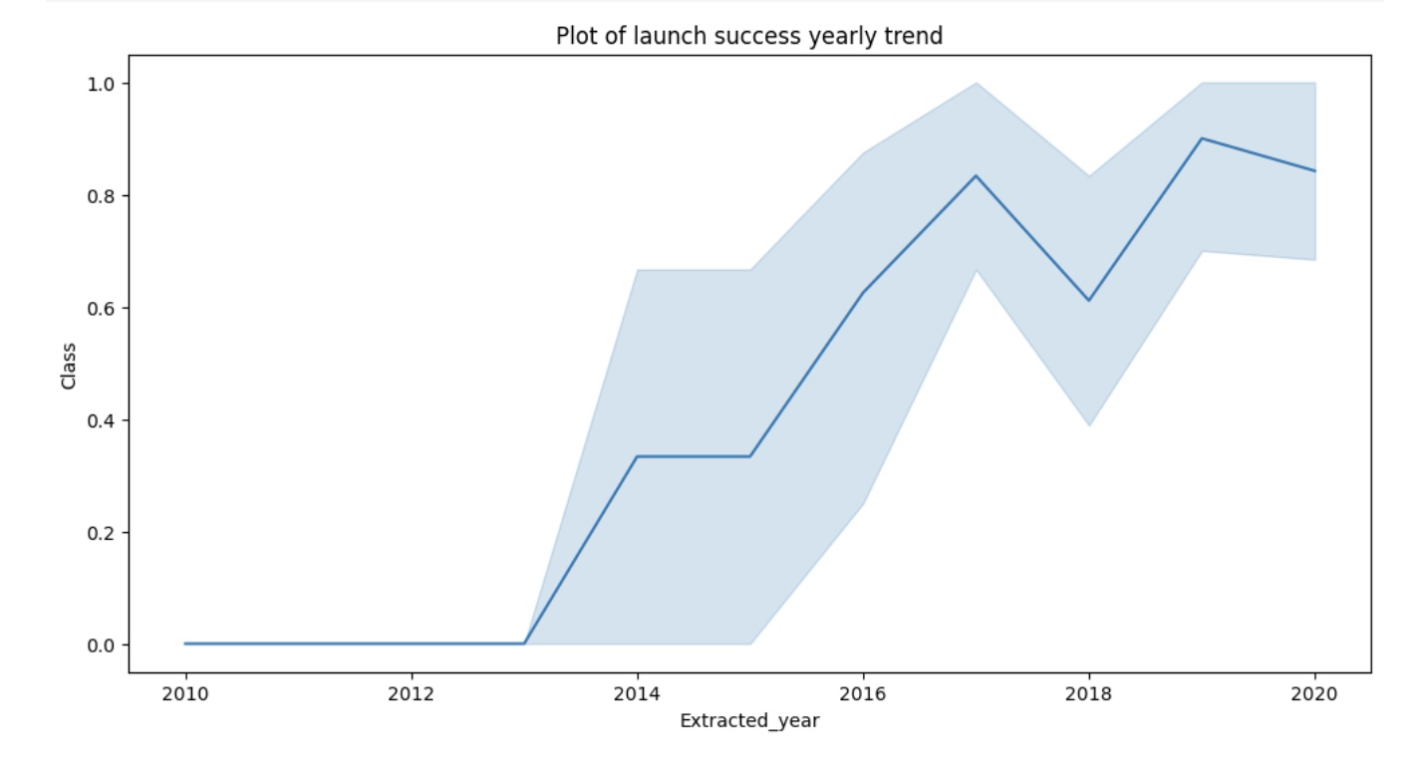
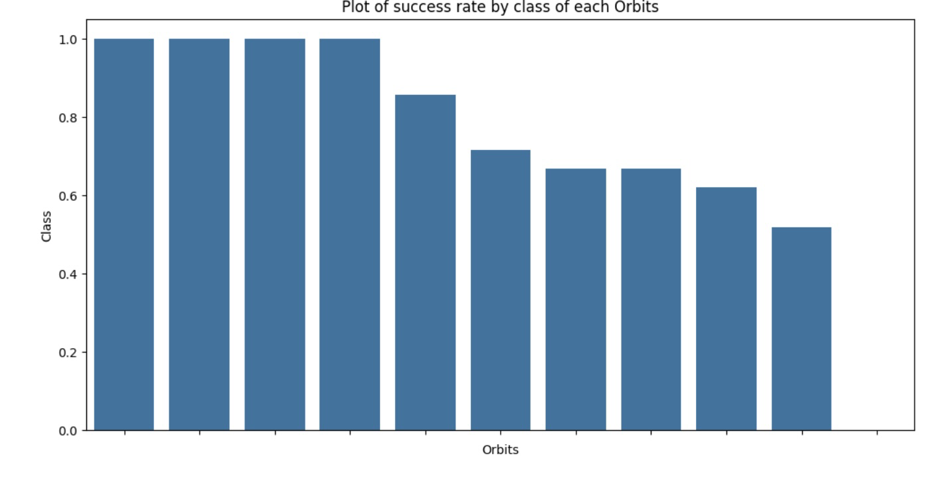
EDA WITH DATA VISUALIZATION
We explored the data by visualizing the relationship between flight number and launch Site, payload and launch site, success rate of each orbit type, flight number and orbit type, the launch success yearly trend.
The link to the notebook is Data Visualization

Slide 10
EDA with SQL
We loaded the SpaceX dataset into an SQL database without in the jupyter notebook.
We applied EDA with SQL to get insight from the data. We wrote queries to find out the following:
-The names of unique launch sites in the space mission.
-The total payload mass carried by boosters launched by NASA (CRS)
-The average payload mass carried by booster version F9 v1.1
-The total number of successful and failure mission outcomes
-The failed landing outcomes in drone ship, their booster version and launch site names.
The link to the notebook is EDA with SQL

Slide 11
Interactive Map with Folium
We marked all launch sites, and added map objects such as markers, circles, lines to mark the success or failure of launches for each site on the folium map.
Using the color-labeled marker clusters, we identified which launch sites have relatively high success rate.
We calculated the distances between a launch site to its proximities. We answered some question like:
-Are launch sites near railways, highways and coastlines.
-Do launch sites keep certain distance away from cities.

Slide 12
PREDICTIVE ANALYSIS(CLASSIFICATION)
We loaded the data using numpy and pandas, transformed the data, split our data into training and testing.
We built different machine learning models and tune different hyperparameters using GridSearchCV.
We used accuracy as the metric for our model, improved the model using feature engineering and algorithm tuning.
We found the best performing classification model.
The link to the notebook is Machine Learning Prediction

Slide 13
RESULTS
Exploratory data analysis results
Interactive analytics demo in screenshots
Predictive analysis results

Slide 14
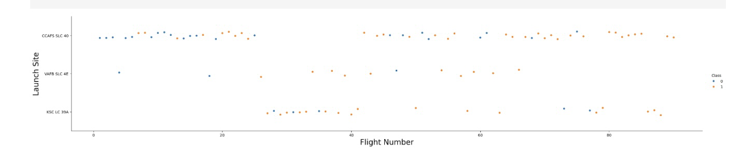
FLIGHT NUMBER VS LAUNCH SITE
From the plot, we found that the larger the flight amount at a launch site, the greater the success rate at a launch site.

Slide 15
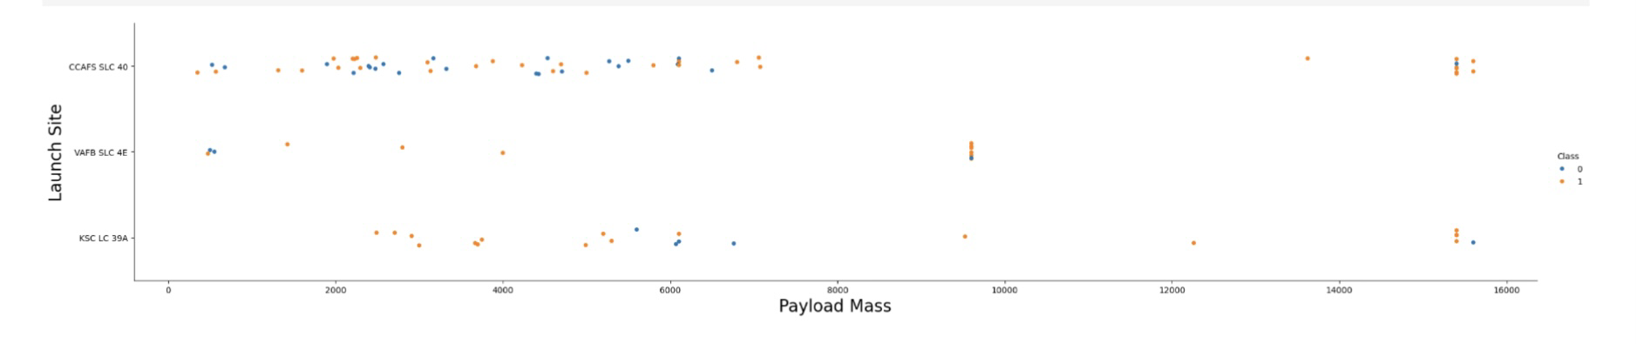
Payload vs Launch Site
The greater the payload mass for launch site CCAFS SLC 40 the higherthe success rate for the rocket.

Slide 16
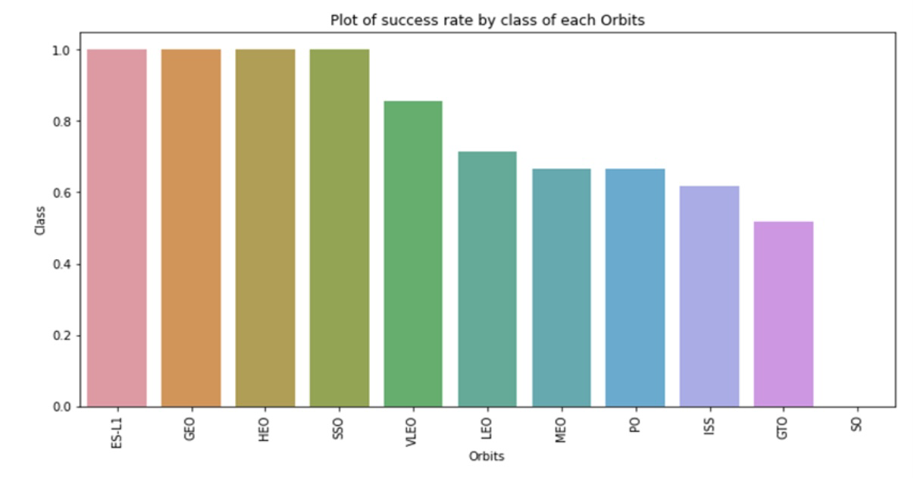
Success Rate vs Orbit type
From the plot, we can see that ES-L1, GEO, HEO, SSO, VLEO had the most success rate.

Slide 17
Launch Success Yearly Trend
From the plot, we can observe an uprise in success rate from 2013 kept to 2020

Slide 18
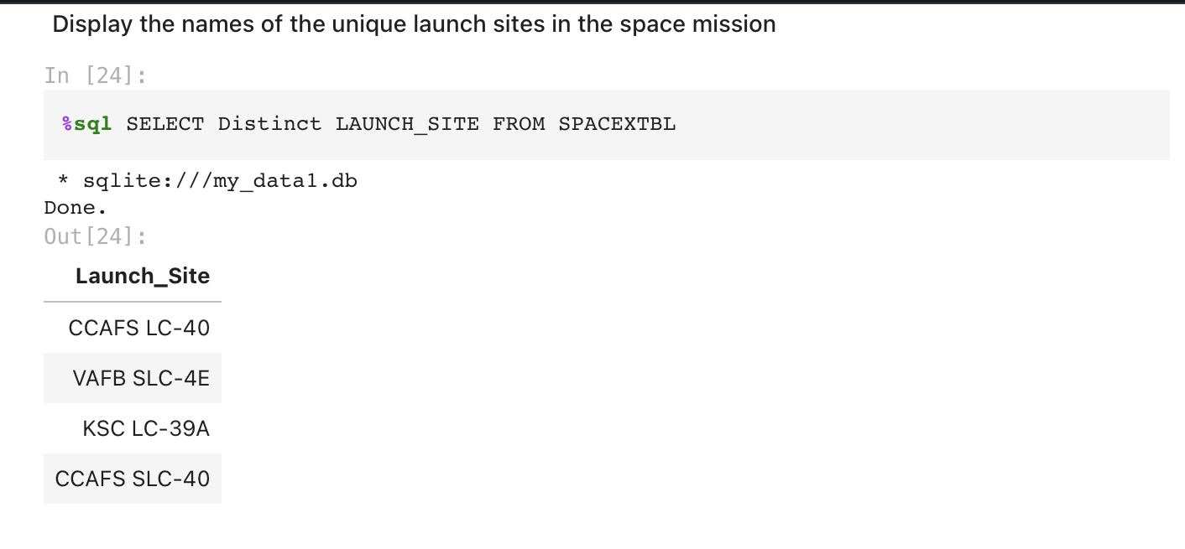
ALL LAUNCH SITES NAME
We used the key word DISTINCT to show only unique launch sites from the SpaceX data.

Slide 19
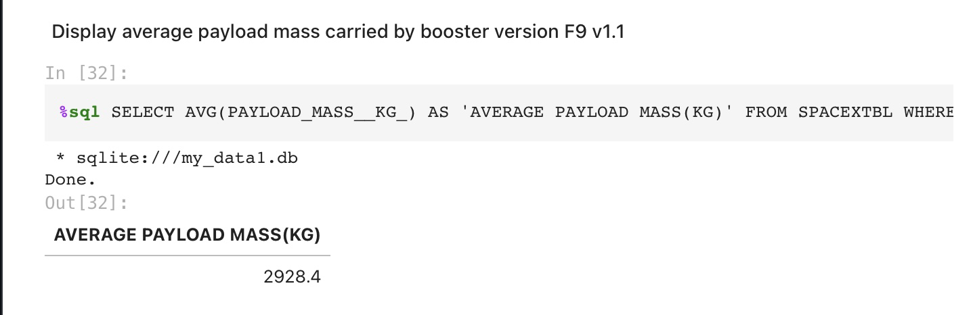
AVERAGE PAYLOAD MASS OF F9 V 1.1
We calculated the average payload mass carried by booster version F9 v1.1 as 2928.4

Slide 20
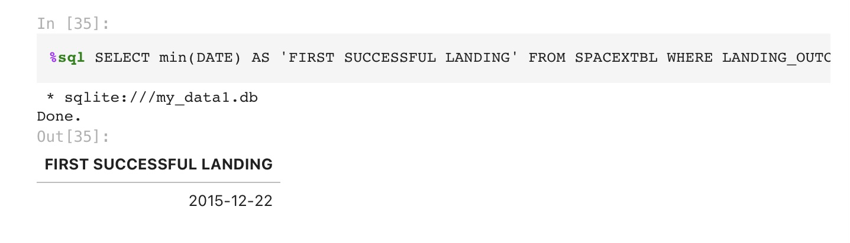
First Successful Ground Landing Date
We observed that the dates of the first successful landing outcome on ground pad was 22nd December 2015

Slide 21
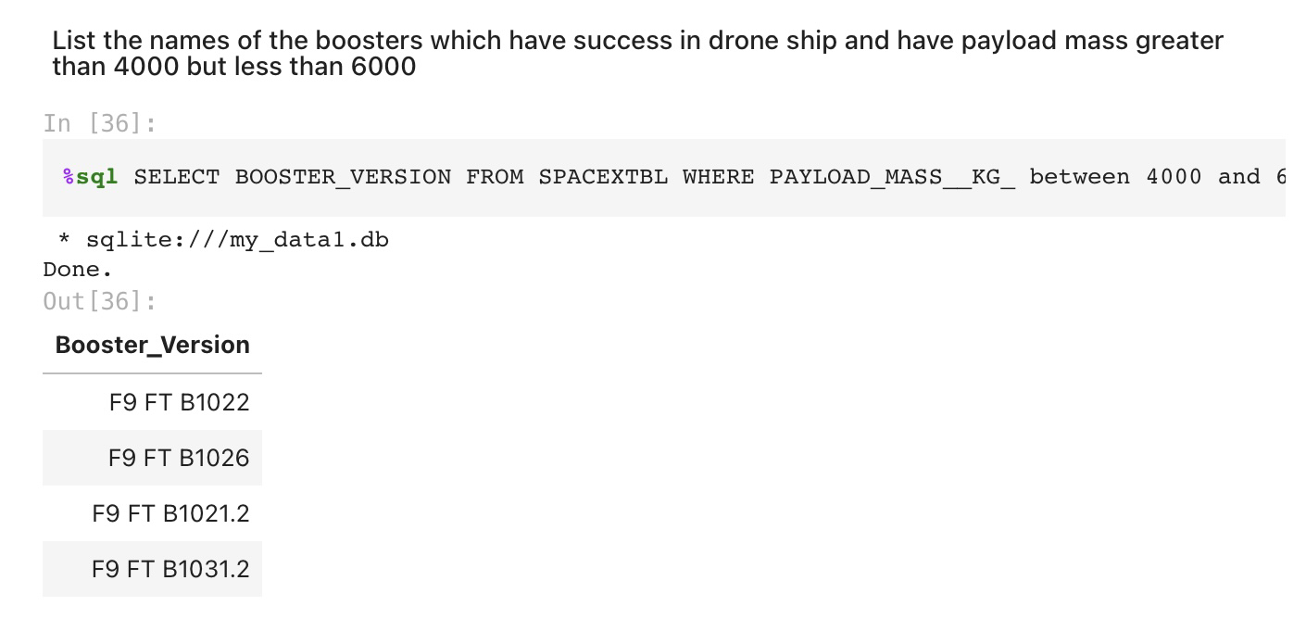
Successful Drone Ship Landing with Payload Mass between 4000 and 6000
We used the WHERE clause to filter for boosters which have successfully landed on drone ship and applied the AND condition to determine successful landing with payload mass greater than 4000 but less than 6000

Slide 22
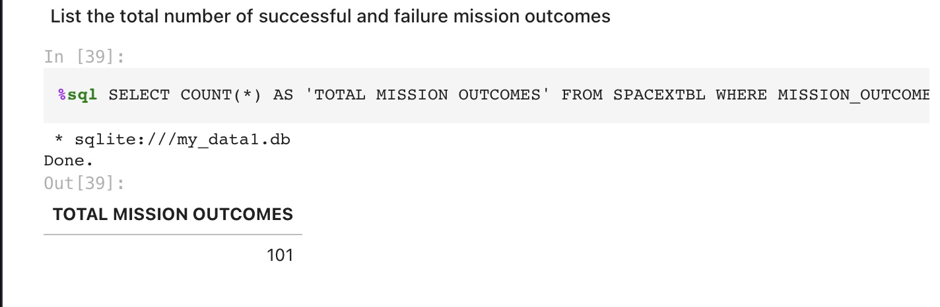
TOTAL NUMBER OF MISSION
We used wildcard like ‘%’ to filter for WHERE MissionOutcomewas a success or a failure.

Slide 23
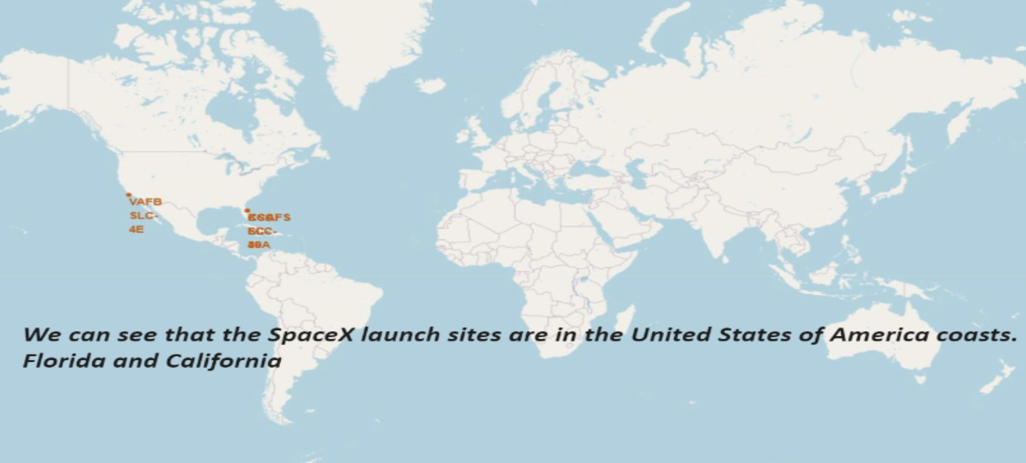
All launch sites global map markers

Slide 24
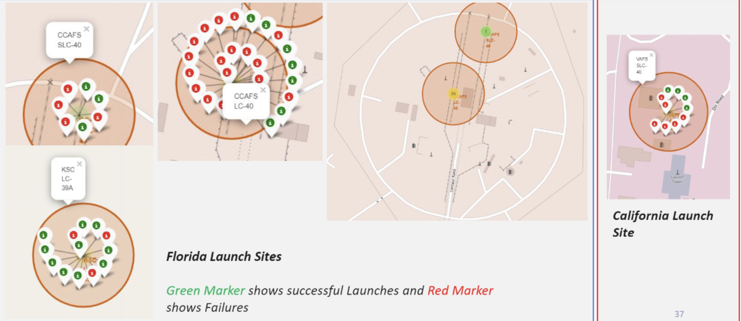
Markers showing launch sites

Slide 25
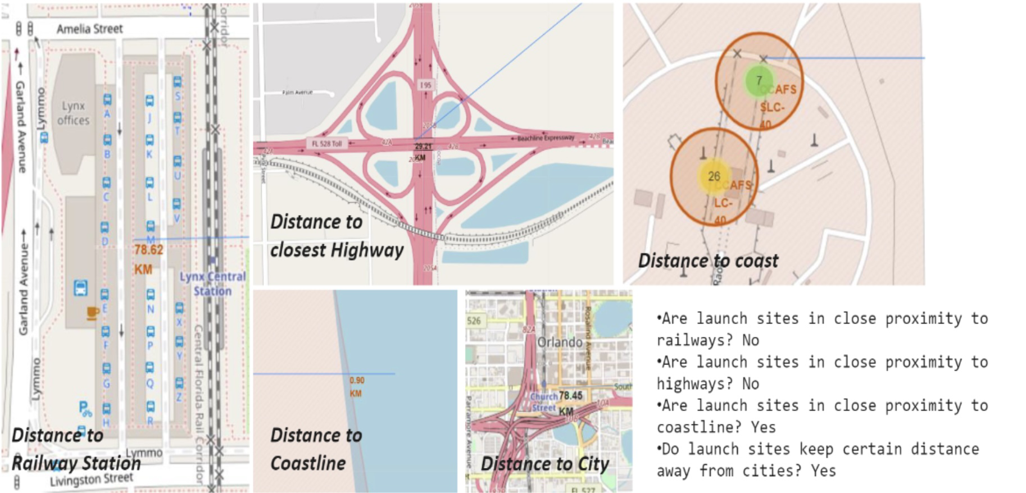
Launch Site distance to landmarks

Slide 26
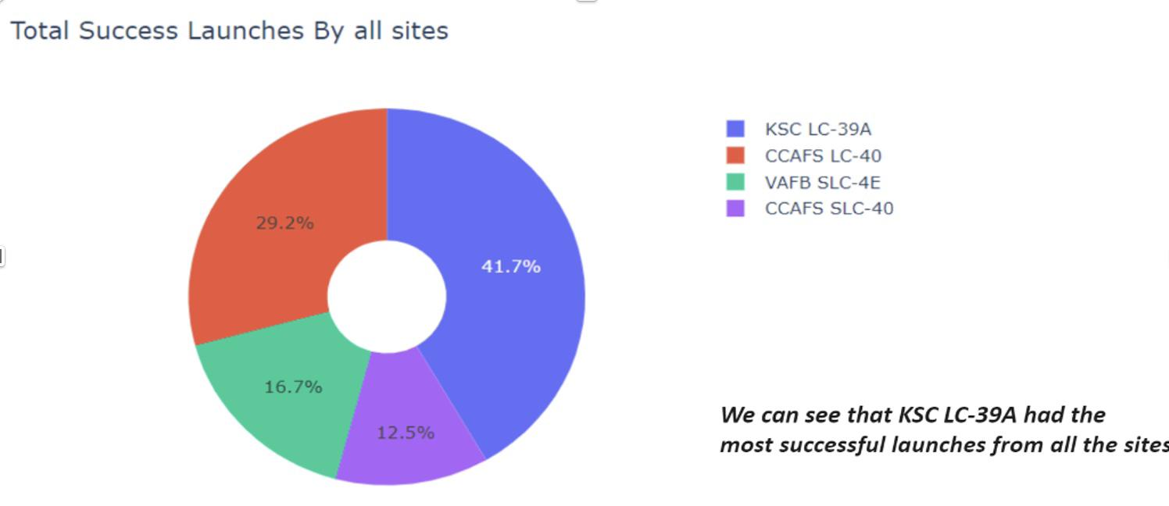
Pie chart showing the success percentage achieved by each launch site

Slide 27
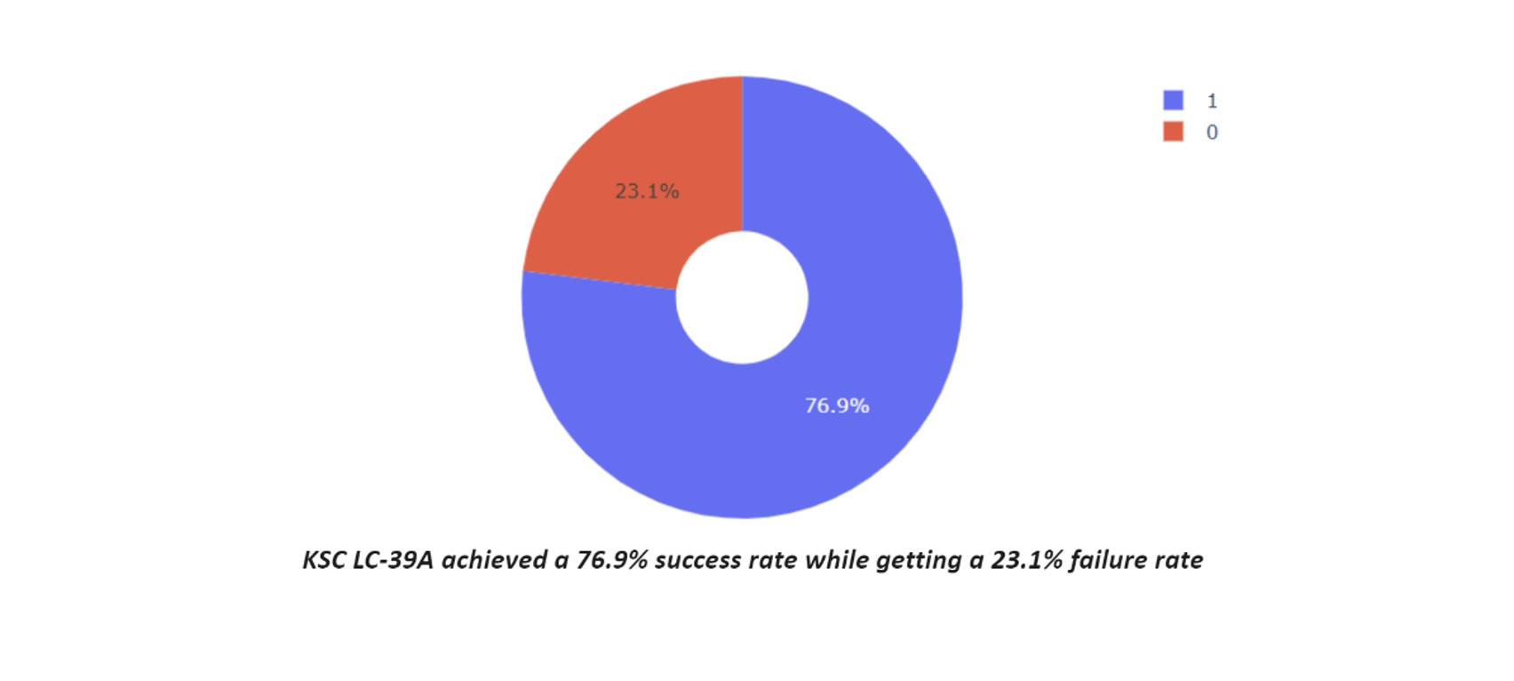
Pie chart for the Launch site with the highest launch success ratio

Slide 28
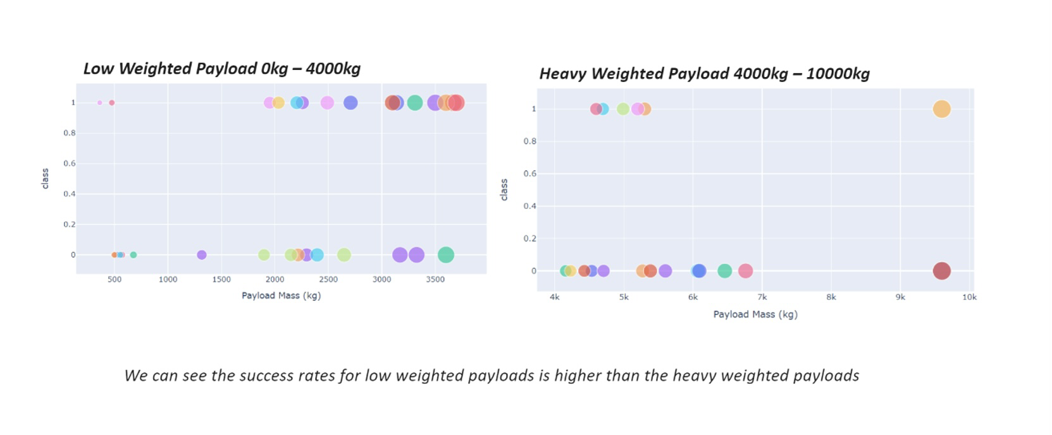
Scatter plot of Payload vs Launch Outcome for all sites

Slide 29
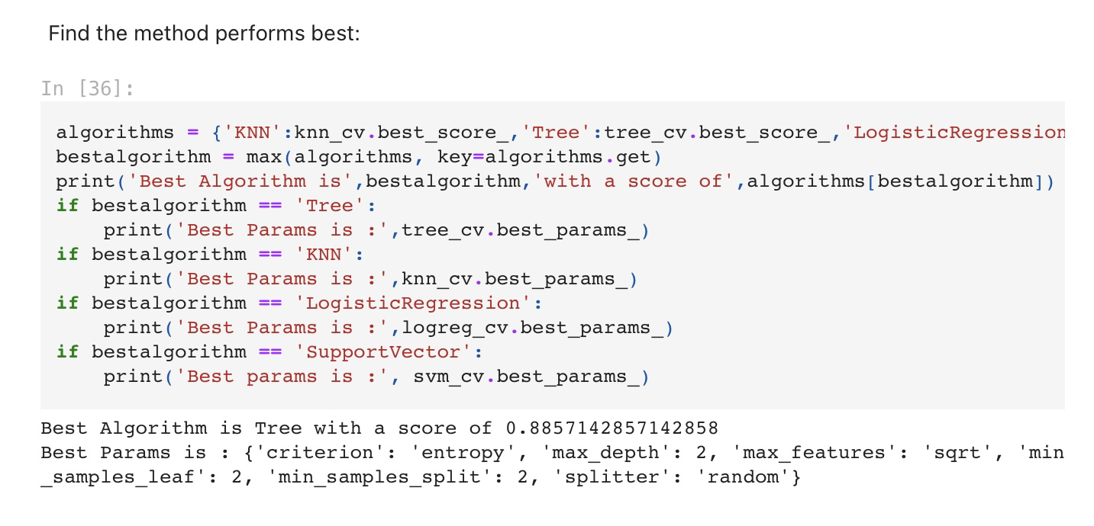
CLASSIFICATION ACCURACY
The decision tree classifier is the model with the highest classification accuracy

Slide 30
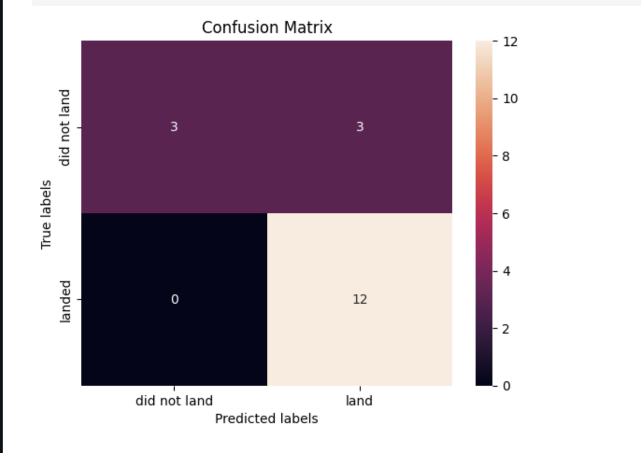
CONFUSION MATRIX
The confusion matrix for the decision tree classifier shows that the classifier can distinguish between the different classes.

Slide 31
CONCLUSION
In conclusion, we found out that:
The larger the flight amount at a launch site, the greater the success rate.
Launch success rate began to surge in 2013 up to 2020.
Orbits ES-L1, GEO, HEO, SSO, VLEO had the most success rate.
KSC LC-39A had the most successful launches of any sites.
The Decision tree classifier is the best machine learning algorithm for this task

